Slide 1

Weather website
SUBMITTED T0: MR. MEHARBAN ALI
SUBMITTED BY : ANJALI TYAGI
(2100680100060)

Slide 2

TABLE OF CONTENTS
OBJECTIVE
INTRODUCTION
FLOWCHART
TECHNOLOGIES

Slide 3

OBJECTIVE
Due to rapid growth of technology, users are switched over from the traditional method for getting weather report to electronic method of getting weather report. users use software applications rather than manual system as a main vehicle to get the weather report. Some of the following features are:-
1. Saves time and efforts.
2. Convenience of weather report from home.
3. Every city weather report are available.
4. Good accuracy of weather at that time.
5. Get detailed information of the weather report

Slide 4

introduction
To summarize and brief in short, Weather App is the application of science and technology to predict the conditions of the atmosphere for a given location and time. People have attempted to predict the weather informally for millennia and formally since the 19th century. Weather forecasts are made by collecting quantitative data about the current state of the atmosphere, land, and ocean and using meteorology to project how the atmosphere will change at a given place. It is very important to get educated on the current weather situation of a particular location as preferred since it affects the day to day life of everyone.
It's a weather app that takes a city as input and provides weather details.

Slide 5
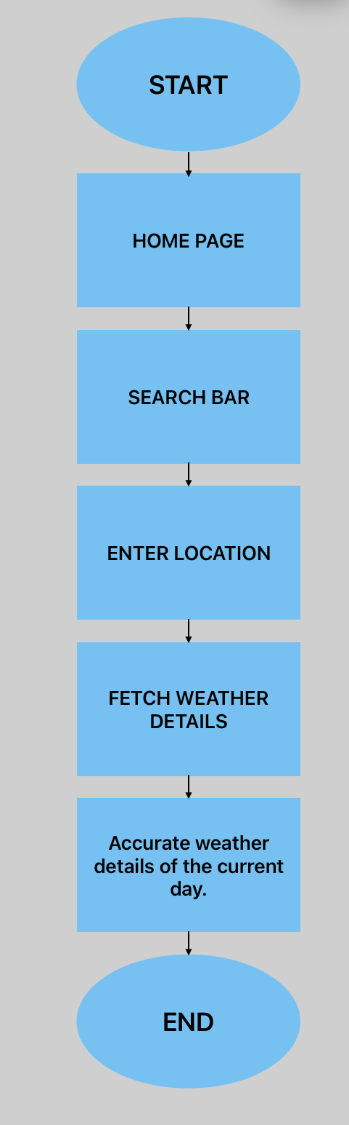
Flowchart

Slide 6
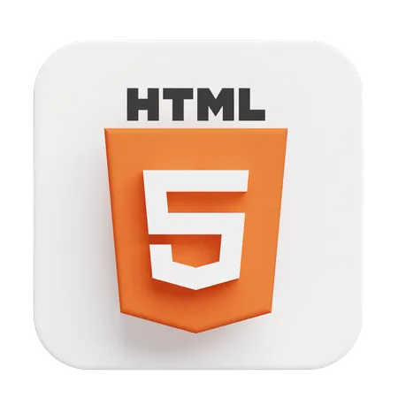
technologies
HTML (Hypertext Markup Language):
HTML is the backbone of web pages, used to structure the content and provide a logical layout.
It consists of a set of tags and elements that define the various parts of a web page, such as headings, paragraphs, lists, links, images, forms, and more.
HTML is not responsible for the visual appearance of the content but rather the semantic structure and hierarchy.
It is a markup language that allows web developers to create the structure and layout of web documents.
Example HTML tag: <p>This is a paragraph</p>

Slide 7

.
CSS (Cascading Style Sheets):
CSS is a stylesheet language that complements HTML by controlling the presentation and styling of web content.
It allows developers to define the look and feel of a web page, including aspects like colors, fonts, spacing, positioning, and responsiveness.
CSS separates the content from its presentation, making it easier to maintain and update the visual design of a website.
CSS can be applied to HTML elements using selectors, properties, and values to create specific styles.
Example CSS rule: p { color: blue; font-size: 16px; }

Slide 8

.
JavaScript:
JavaScript often abbreviated as JS, is a programming language that is one of the core technologies of the World Wide Web, alongside HTML and CSS.
JavaScript is a powerful programming language that can add interactivity to a website. It was invented by Brendan Eich .
JavaScript itself is relatively compact, yet very flexible. Developers have written a variety of tools on top of the core JavaScript language, unlocking a vast amount of functionality with minimum effort. These include:
Browser Application Programming Interfaces (APIs) built into web browsers, providing functionality such as dynamically creating HTML and setting CSS styles; collecting and manipulating a video stream from a user's webcam, or generating 3D graphics and audio samples.
Third-party APIs that allow developers to incorporate functionality in sites from other content providers, such as Twitter or Facebook.
Third-party frameworks and libraries that you can apply to HTML to accelerate the work of building sites and applications .an add

Slide 9


THANKYOU

